Slide 1
Digital Portfolio
STUDENT NAME: BRINDHA V
REGISTER NO AND NMID: DDB704F76406254967D4F8B36D53291E
DEPARTMENT: BCA(Bachalor Of Computer Applications)
COLLEGE: Akshaya College of arts and Science / Bharathiyar University

Slide 2
PROJECT TITLE
NeoFolio: A Creative Digital Portfolio

Slide 3


AGENDA
Problem Statement
Project Overview
End Users
Tools and Technologies
Portfolio design and Layout
Features and Functionality
Results and Screenshots
Conclusion
Github Link
3/21/2024 Annual Review

Slide 4

PROBLEM STATEMENT
These days, just having a plain resume isn’t enough. Resumes are static and don’t really show creativity, personality, or interactivity. Recruiters and clients usually prefer something more visual and engaging — a platform where they can see real skills and projects. Without this kind of portfolio, many talented people miss the chance to stand out.

Slide 5

PROJECT OVERVIEW
My project is called NeoFolio. It’s an interactive digital portfolio designed with a dark futuristic theme and neon glow effects. The idea is to make portfolios look more alive — highlighting skills, achievements, and projects in a professional but eye-catching way. I built it with HTML, CSS, and JavaScript, focusing on interactivity, smooth transitions, and a glowing modern design.

Slide 6

WHO ARE THE END USERS?
🎓 Students who want to showcase academic work in a creative way.
💼 Job seekers who want something more than a regular resume.
👨‍💻 Freelancers & creators who need a cool way to show their past work.
🏢 Recruiters or employers who can quickly explore a candidate’s skills.

Slide 7

TOOLS AND TECHNIQUES
Frontend: HTML5, CSS3, JavaScript
Editor: Visual Studio Code
Hosting: GitHub Pages or Netlify
Design: Dark mode + neon glow effects, animations, and flip cards

Slide 8
POTFOLIO DESIGN AND LAYOUT
The portfolio follows a modern glowing look with:
A neon glowing header with animated background
A glass-style sidebar menu with interactive buttons
An About section using a flip-card effect (front shows photo, back shows bio)
A Projects section with hover-glow project cards
A Contact section with interactive icons (GitHub, email, phone)
A sticky footer with glowing highlights
‹#›

Slide 9
FEATURES AND FUNCTIONALITY
🚀 Dynamic navigation — sections load instantly with JavaScript
🎨 Futuristic dark + neon design for a standout look
🖱️ Smooth hover animations and transitions
📂 Project showcase with glowing hover cards
📱 Fully responsive — works on mobile, tablet, and desktop
🔗 Clickable contact links for easy networking

Slide 10

RESULTS AND SCREENSHOTS
The portfolio turned out exactly as planned:
A complete dark-themed interactive portfolio with neon accents
A fun flip-card effect in the About section
Hover-glow animations for projects and menu buttons
Smooth navigation and modern design
Fully responsive across devices
3/21/2024 Annual Review
‹#›

Slide 11
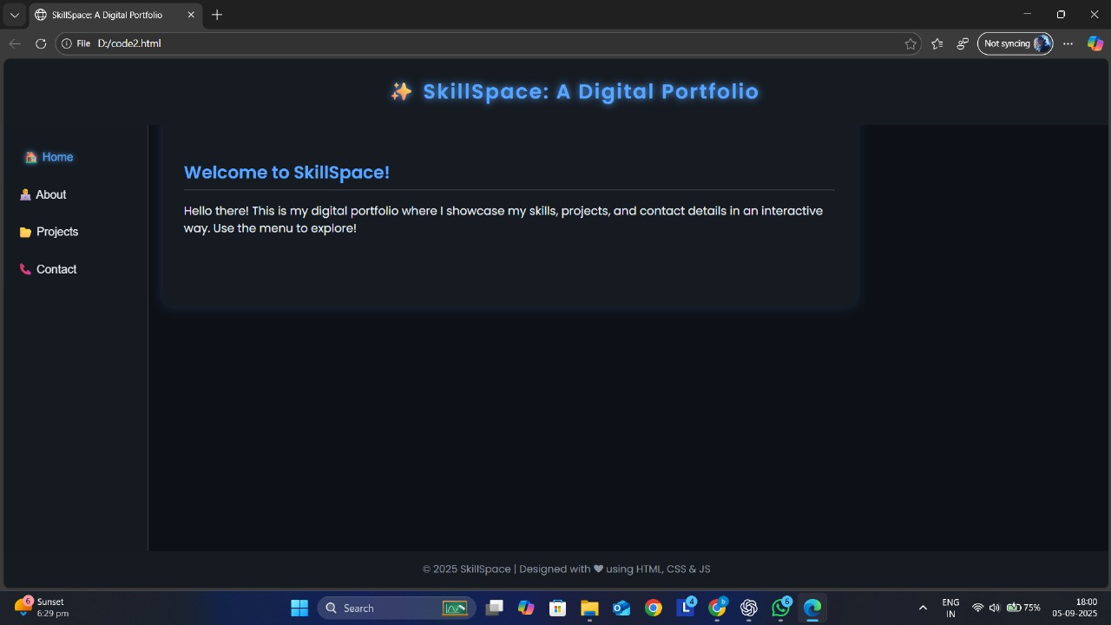

Slide 12
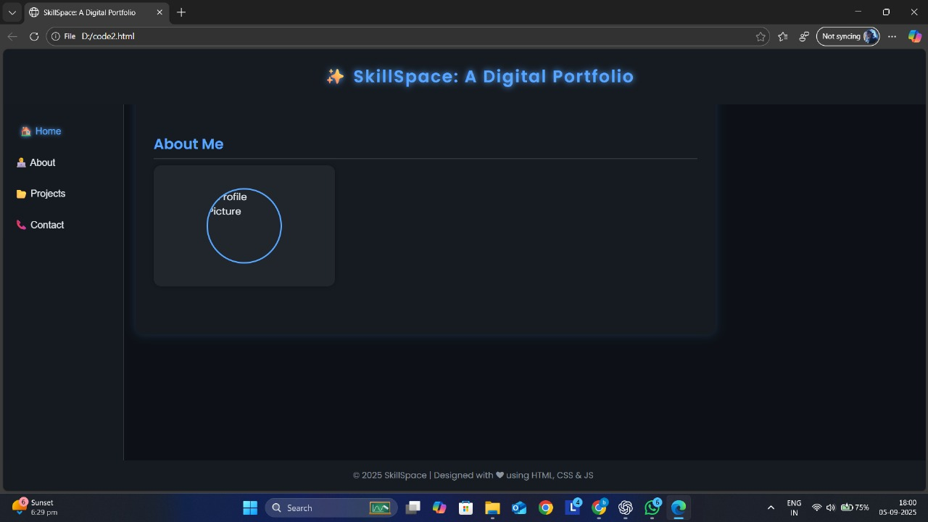

Slide 13
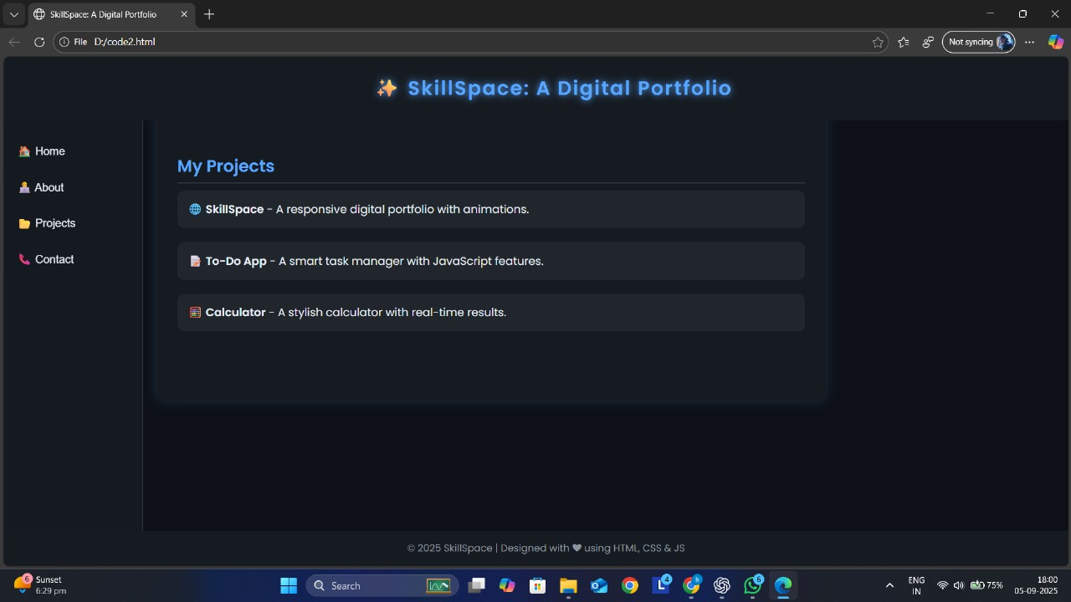

Slide 14
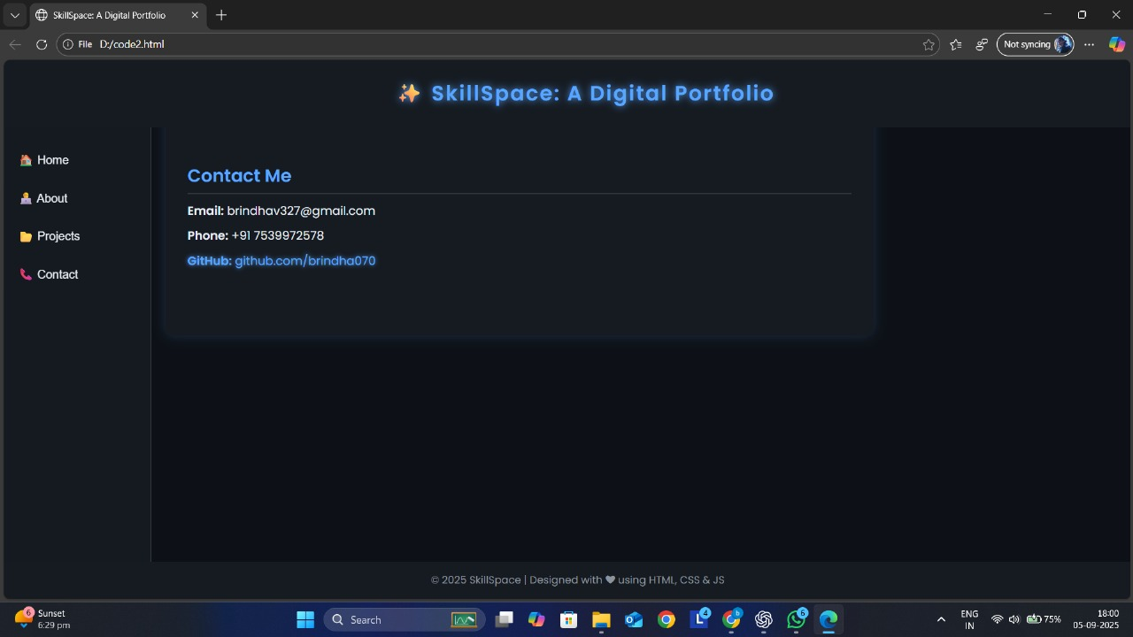

Slide 15
CONCLUSION
The NeoFolio project is more than just a portfolio — it’s a digital identity with a futuristic feel. It helps students, job seekers, and professionals present themselves in a unique way, beyond a simple resume. With its neon theme and interactive design, it grabs attention, makes navigation easy, and shows how basic web technologies can create something creative and impactful.
‹#›

